Slide 1

CSE211
Computer Organization and Design
Lecture : 3 Tutorial: 1 Practical: 0 Credit: 4
Deepak Kumar
(Asst. Professor, LPU)

Slide 2
Register Transfer and Micro-operations <number>
Overview
Register Transfer Language
Register Transfer
Bus and Memory Transfers
Arithmetic Micro-operations
Logic Micro-operations
Shift Micro-operations
Arithmetic Logic Shift Unit
CSE 211

Slide 3
Register Transfer and Micro-operations <number>
MICROOPERATIONS
Computer system microoperations are of four types:
Register transfer microoperations
Arithmetic microoperations
Logic microoperations
Shift microoperations
CSE 211

Slide 4
Register Transfer and Micro-operations <number>
Arithmetic MICROOPERATIONS
The basic arithmetic microoperations are
  Addition
  Subtraction
  Increment
  Decrement
The additional arithmetic microoperations are
  Add with carry
  Subtract with borrow
  Transfer/Load
  etc. …
Summary of Typical Arithmetic Micro-Operations
  R3 ← R1 + R2 Contents of R1 plus R2 transferred to R3
  R3 ← R1 - R2 Contents of R1 minus R2 transferred to R3
  R2 ← R2’ Complement the contents of R2
  R2 ← R2’+ 1 2's complement the contents of R2 (negate)
  R3 ← R1 + R2’+ 1 subtraction
  R1 ← R1 + 1 Increment
  R1 ← R1 - 1 Decrement
CSE 211

Slide 5
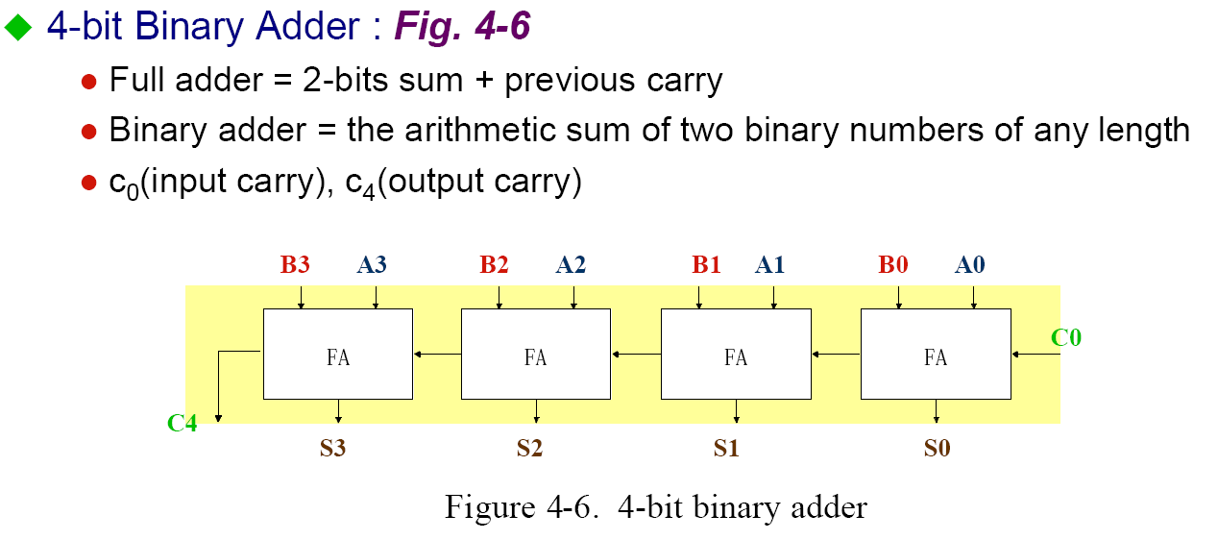
Register Transfer and Micro-operations <number>
Binary Adder
CSE 211

Slide 6
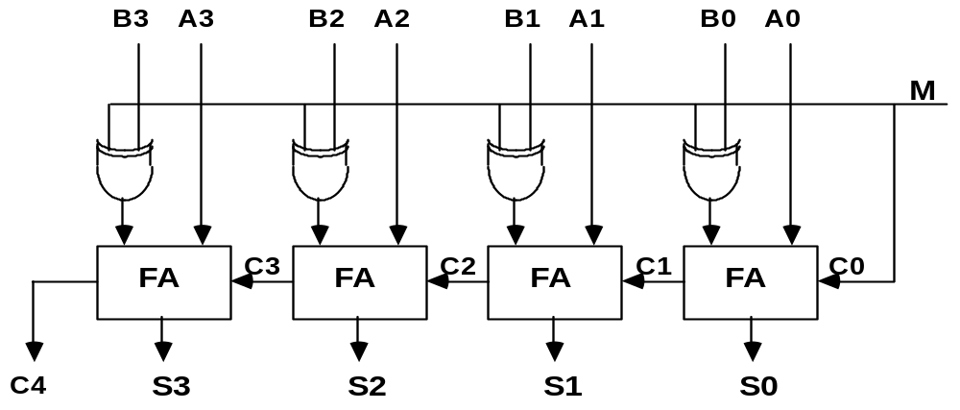
Register Transfer and Micro-operations <number>
Binary Adder-Subtractor
Binary Adder-Subtractor
Mode input M controls the operation
  M=0 ---- adder
  M=1 ---- subtractor
CSE 211

Slide 7
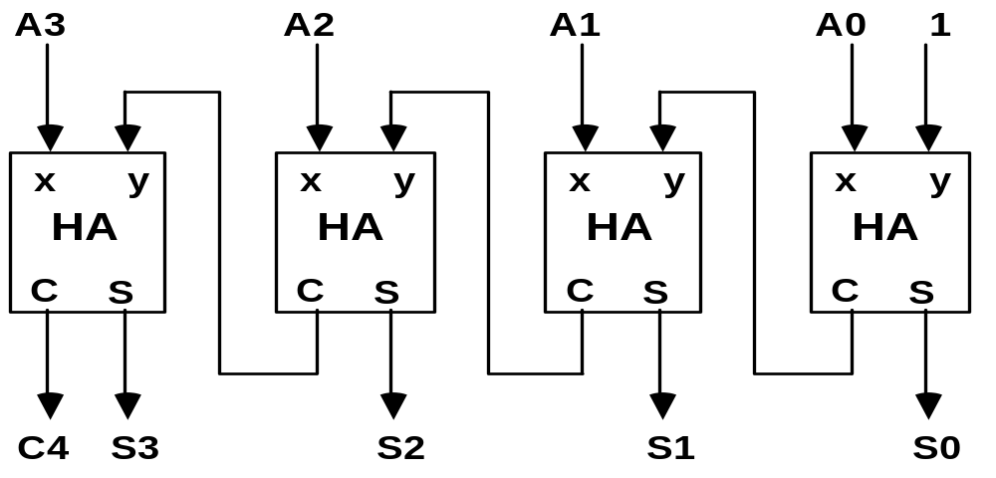
Register Transfer and Micro-operations <number>
Binary Incrementer
Binary Incrementer
CSE 211

Slide 8
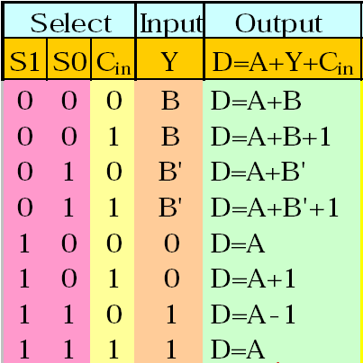
Register Transfer and Micro-operations <number>
Arithmetic Circuits
Cin
S1
S0
A0
X0
C0
S1
FA
D0
S0
B0
0
4x1
Y0
C1
1
MUX
2
3
A1
X1
C1
S1
FA
D1
S0
B1
0
4x1
Y1
C2
1
MUX
2
3
A2
X2
C2
S1
FA
D2
S0
B2
0
4x1
Y2
C3
1
MUX
2
3
A3
X3
C3
S1
FA
D3
S0
B3
0
4x1
Y3
C4
1
MUX
2
Cout
3
0
1
CSE 211

Slide 9



